Slide 1
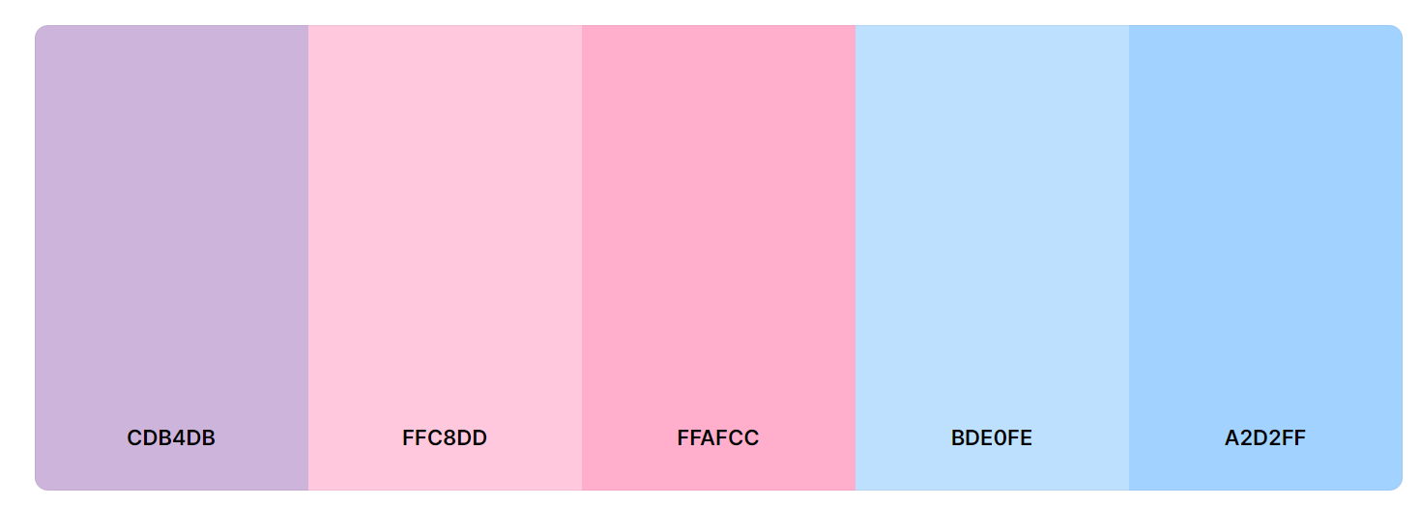
Colour Scheme
Wanted something to do with pink and blue (café and ocean)
Used Coolors to find colour palette
Colour hex codes

Slide 2

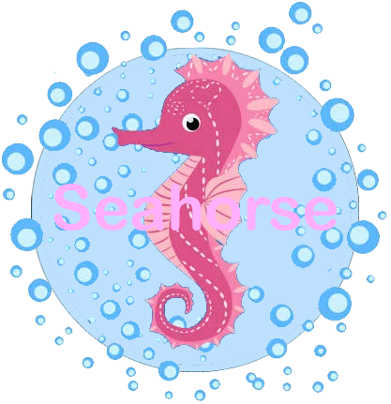
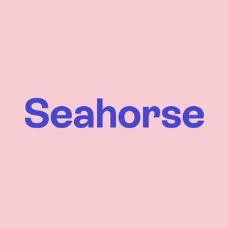
First draft of logo
+
=
Made by me
Made in Photoshop
“Seahorse” font is rial rounded mt bold
Font size is 16
Text colour is #FFC8DD (part of colour scheme)
Circle colour is #BDE0FE (part of colour scheme)

Slide 3
Second and final draft of logo

